Slide 1
Backtracking
N Queen Problem

Slide 2
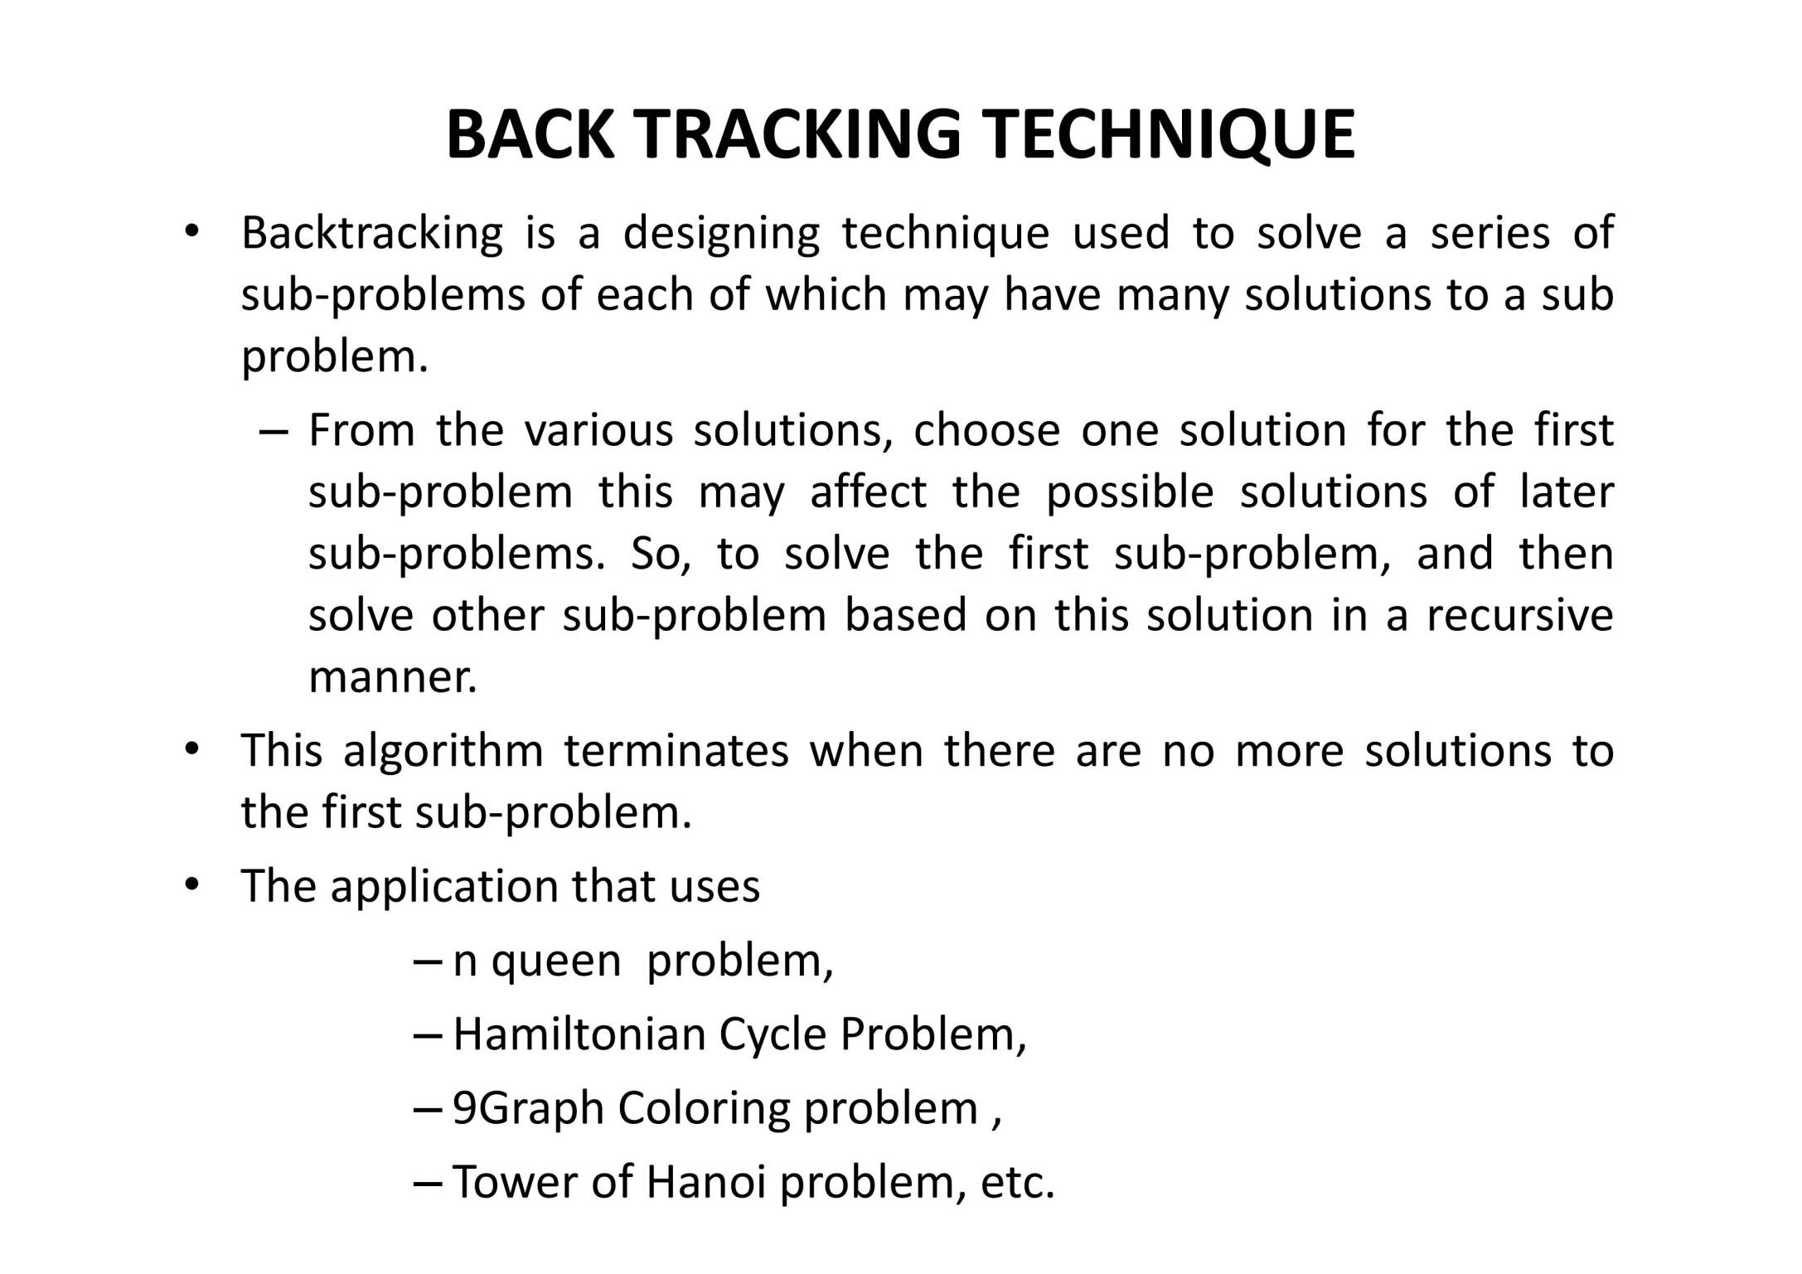

Slide 3
N-Queen Problem
A classic combinatorial problem is to place eight queens on an 8 x 8 chessboard so that o two “attack”, that is , so that no two of them are on the same row, column, or diagonal.
Lets number the rows and columns of the chess board 1 through 8
The queens can also be numbered 1 through 8

Slide 4
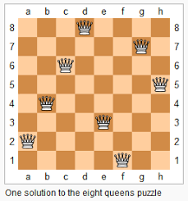

Slide 5
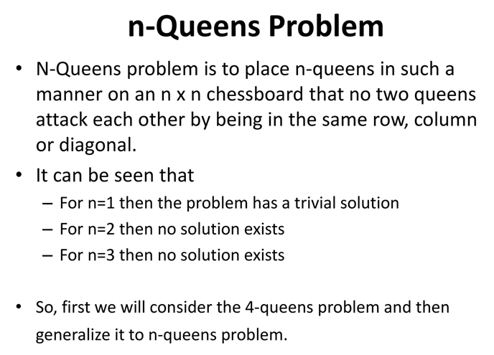

Slide 6
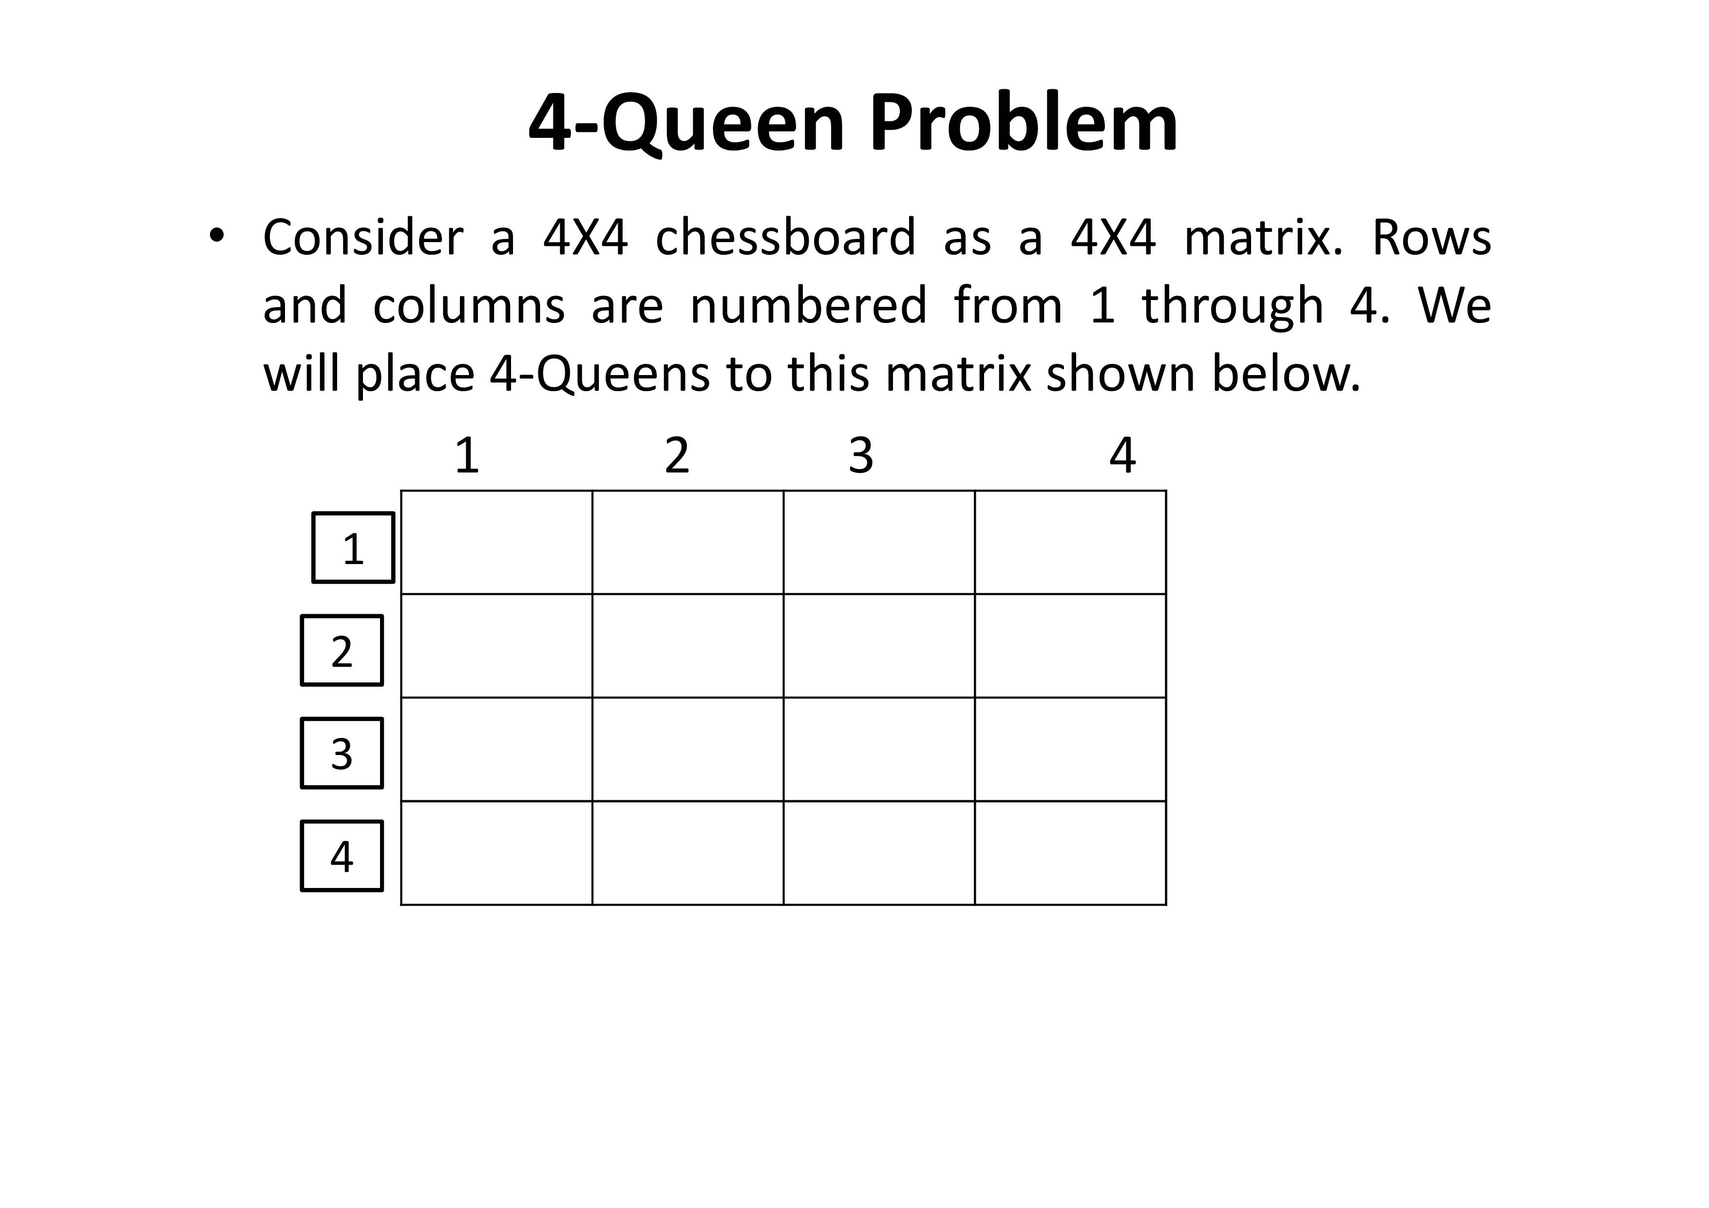

Slide 7
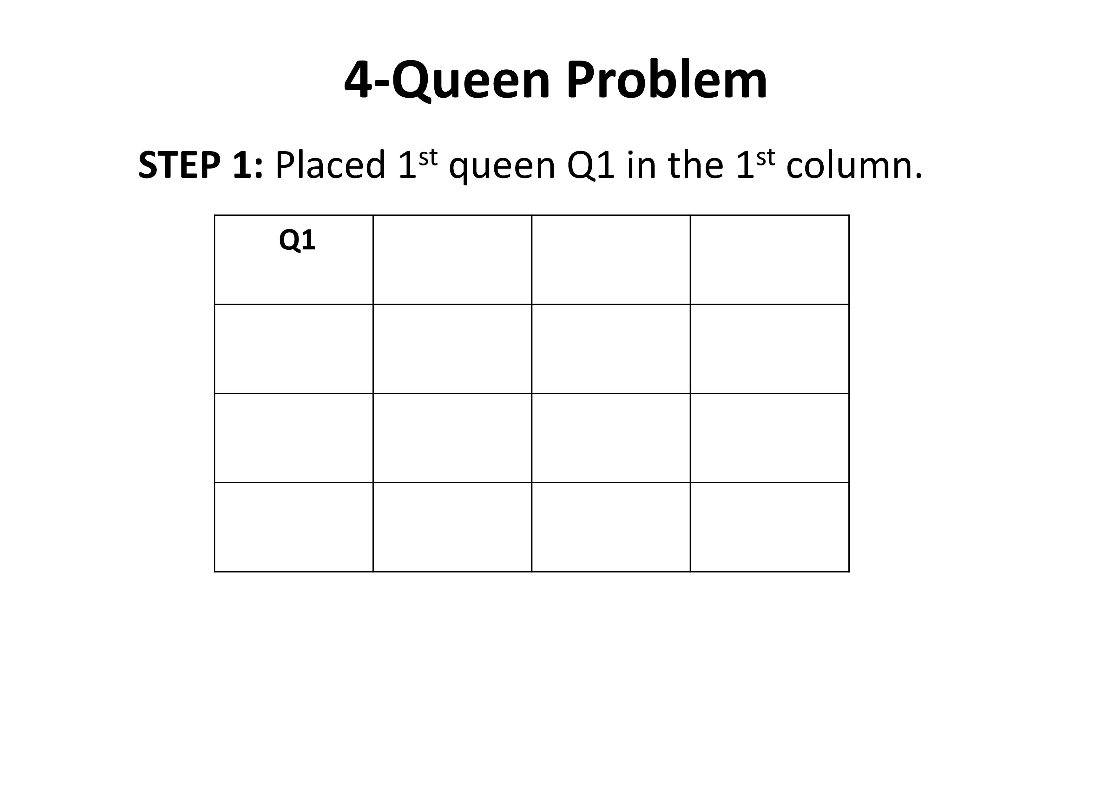

Slide 8
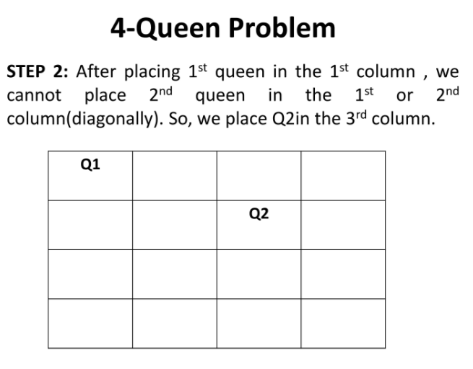

Slide 9
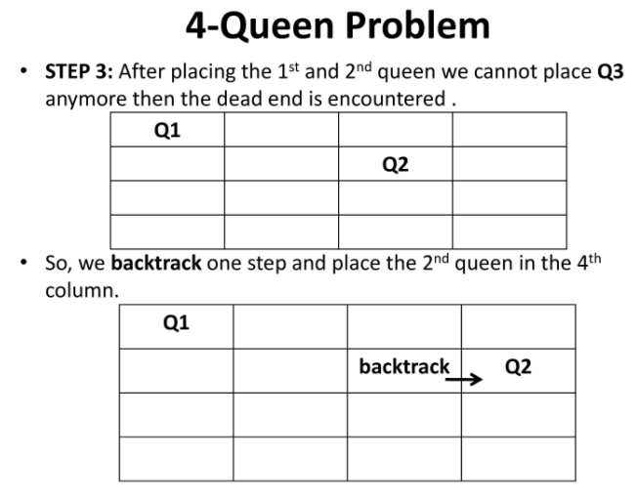

Slide 10
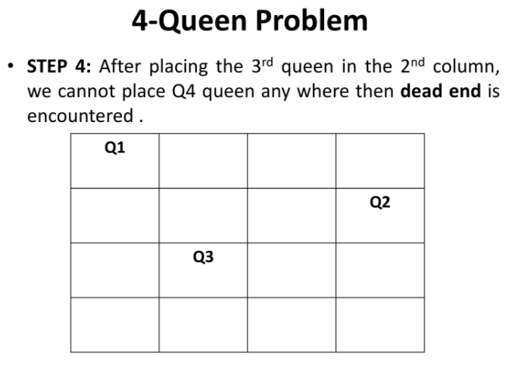

Slide 11
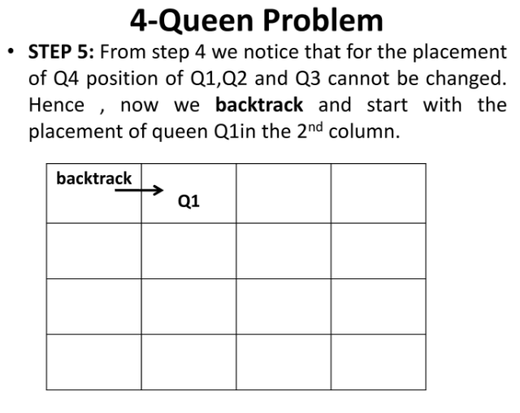

Slide 12
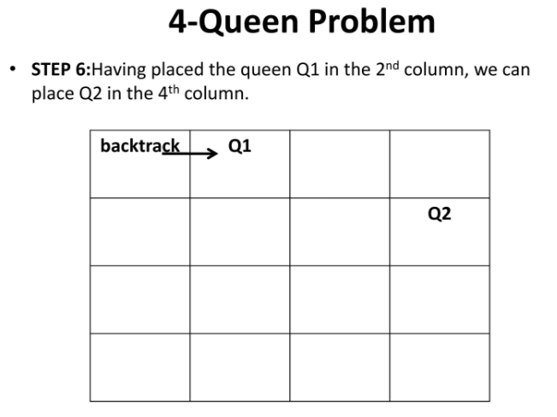

Slide 13
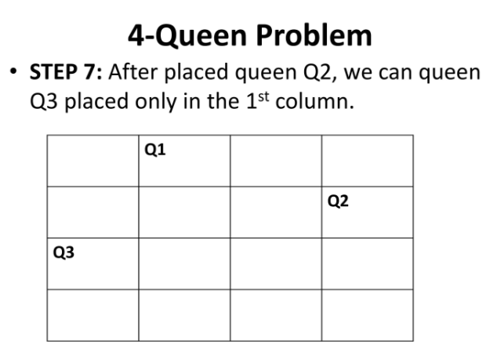

Slide 14
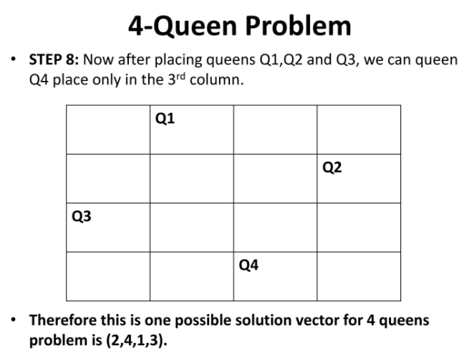

Slide 15
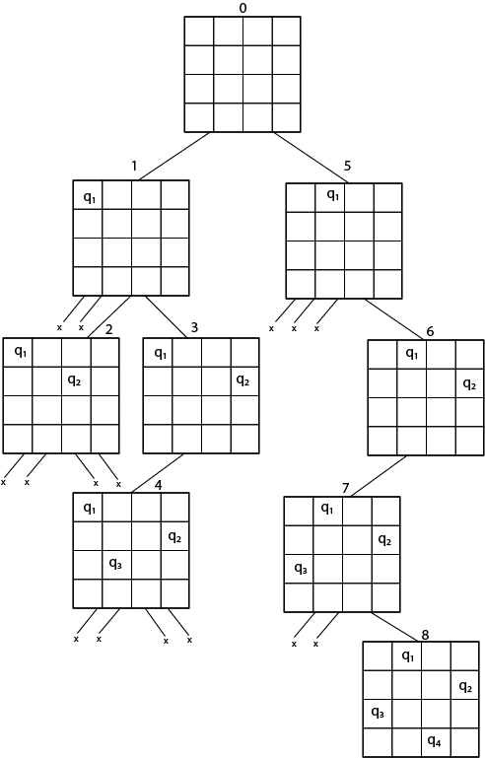
State Space Search for 4 Queen Problem

Slide 16
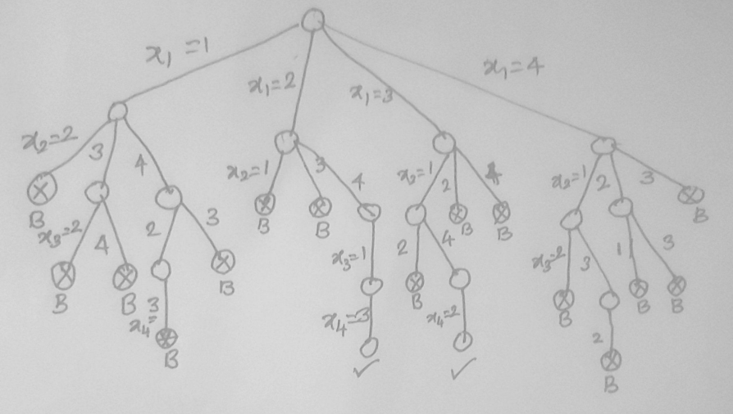

Slide 17
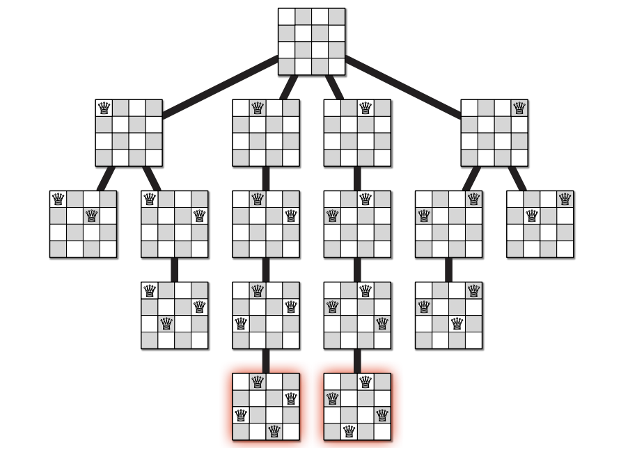

Slide 18
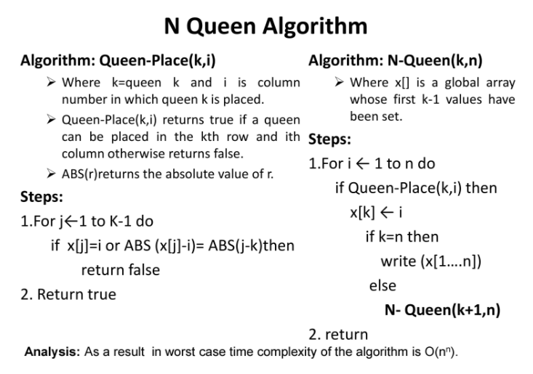

Slide 19
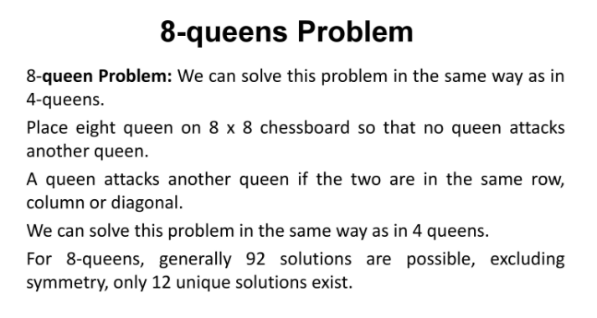

Slide 20
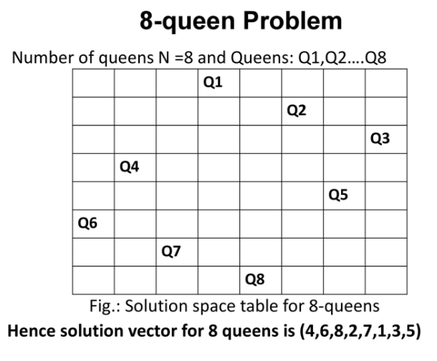

Slide 21
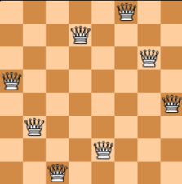
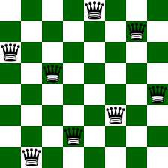
(5,7,1,3,8,6,4,2)
(6,4,7,1,8,2,5,3)
(2,6,4,8,3,2,7,5)
(2,4,6,8,3,2,7,5)
(3,5,2,8,1,7,4,6)

